Slide 1
Physical Pharmacy Lab 6 CPT 203/PT 203
Hydrophilic-Lipophilic Balance (HLB)

Slide 2
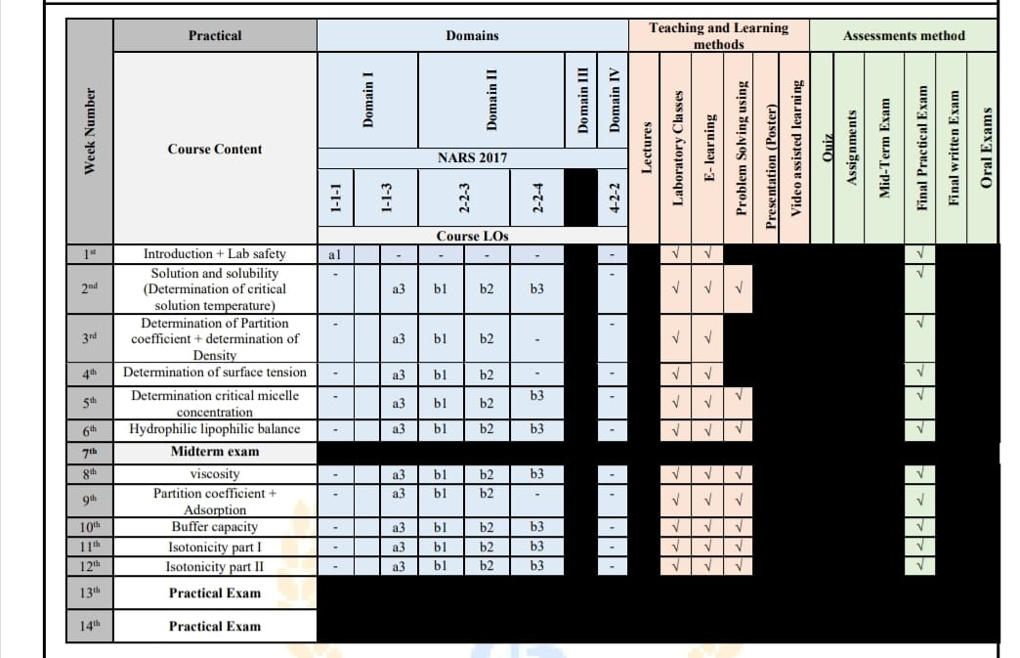

Slide 3
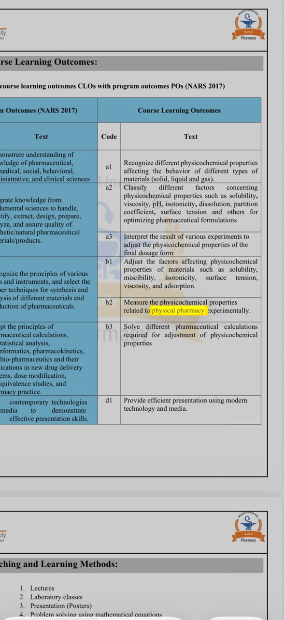

Slide 4
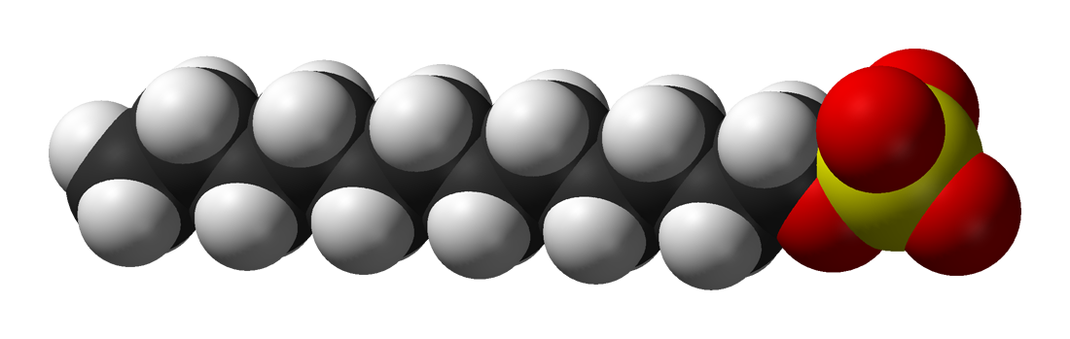
Surface active agent (Surfactants)
Hydrophilic head
(lypophobic)
Hydrophobic tail (lypophilic)
Surfactants are amphiphilic compounds with two opposing portions, one part is hydrophilic and the other is hydrophobic that decrease the surface tension or interfacial tension between two liquids, a liquid and a gas, or a liquid and a solid.

Slide 5
Hydrophilic-Lipophilic Balance (HLB)
It is the relative efficiency of the hydrophilic portion of the surfactant molecule to its lipophilic portion of the same molecule.

Slide 6
HLB Griffin`s Scale
It is an arbitrary scale between 0 and 20 which expresses numerically the size and strength of the polar portion relative to the non-polar portion of the molecule.

Slide 7
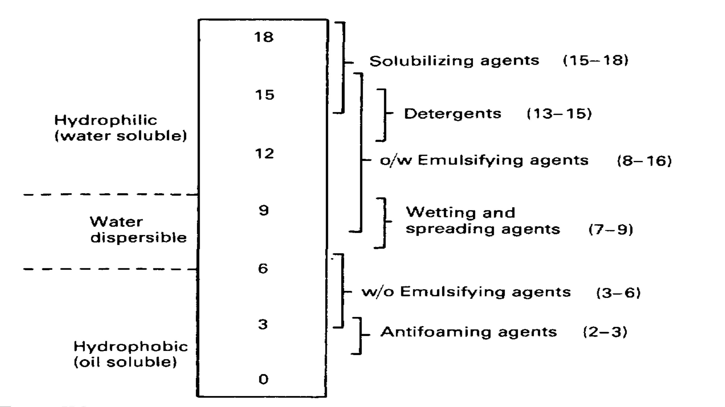

Slide 8
Aim of HLB Griffinˊs Scale
It provides a systematic method of selecting mixtures of emulsifying agents to produce physically stable emulsions.
The higher surfactant HLB value, the more hydrophilic it is.
The lower surfactant HLB value, the more lipophilic it is

Slide 9
Determination of the Required HLB values and Blending of Surfactants
Oils used in the formulation of emulsions require a certain HLB value to be formulated as w/o emulsion or o/w emulsion.
For the same oil, the required HLB value for O/W emulsion is higher than the required HLB value for W/O emulsion .

Slide 10
Calculation of the required HLB for a mixture of oils, fats or waxes
1. Total oily phase.
2. %fraction of each ingredient
3. Multiply the required HLB of each ingredient by its fraction from the total oily phase.
4. Add the obtained values to get the total required HLB for the whole oily phase.

Slide 11
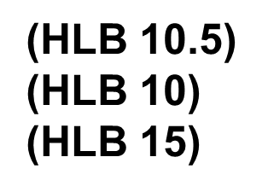
Problem 1
Liquid paraffin 35%
Wool fat 1%
Cetyl alcohol 1%
Emulsifier system 7%
Water to 100%

Slide 12
Solution
The total percentage of the oily phase is 37 and the proportion of each is:
Liquid paraffin 35/37 x 100 = 94.6%
Wool fat 1/37 x 100 = 2.7%
Cetyl alcohol 1/37 x 100 = 2.7%
2. The total required HLB number is obtained as follows:
Liquid paraffin (HLB 10.5) =94.6/100 X 10.5 = 9.93
Wool fat (HLB 10) =2.7/100 x 10 = 0.3
Cetyl alcohol (HLB 15) =2.7/100 X 15 = 0.4
Total required HLB = 10.63

Slide 13
Calculation of ratio of emulsifier to produce aparticular required HLB value
The HLB of the mixture of surfactants, consisting of fraction x of A and (1-x) of B is assumed to be the algebraic mean of the two HLB numbers,
HLB mixture= x HLB (A)+ (1-x) HLB(B)
Rearrangement the above equation in percent (%) form will be
A = 100 (X-HLB)B/ (HLB)A– (HLB)B
B = 100 – A
Where X is the required HLB of the surfactant (oil) mixture, B is Lower 𝐇𝐋𝐁 and A is 𝐇𝐢𝐠𝐡𝐞𝐫 𝐇𝐋𝐁

Slide 14
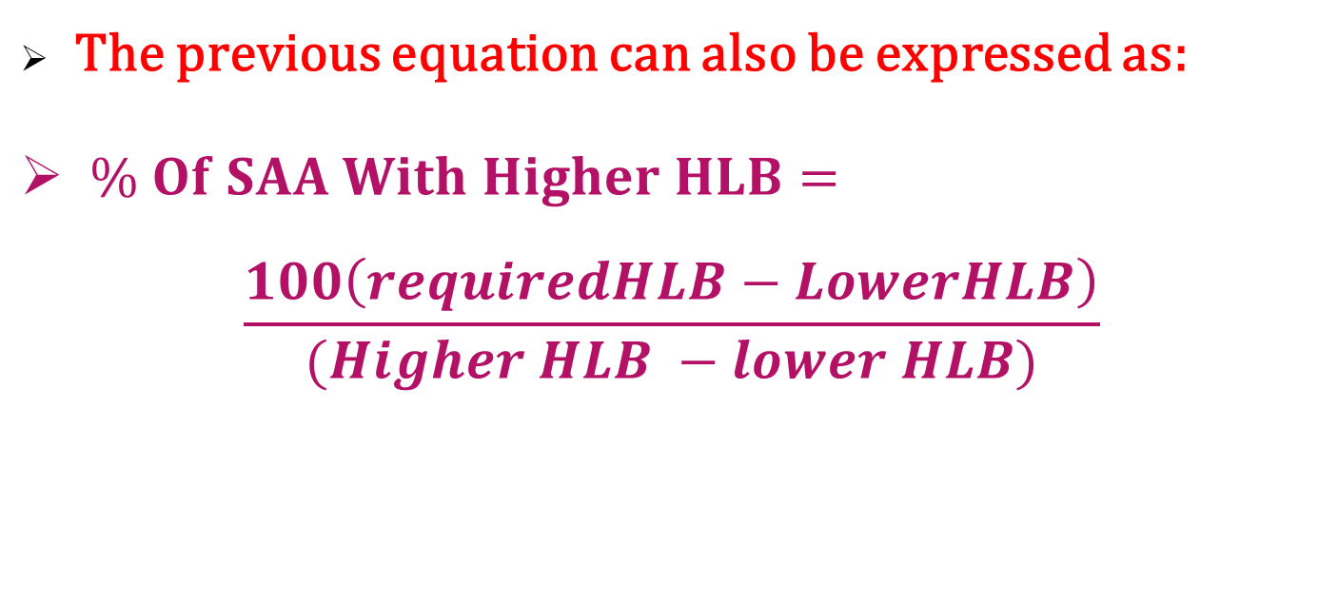
The previous equation can also be expressed as:
$\% Of SAA With Higher HLB=$
$$\frac{100\left(requiredHLB−LowerHLB\right)}{(Higher HLB −lower HLB)}$$
% of SAA of lower 𝐻𝐿𝐵 =
100 - % of SAA of higher HLB

Slide 15
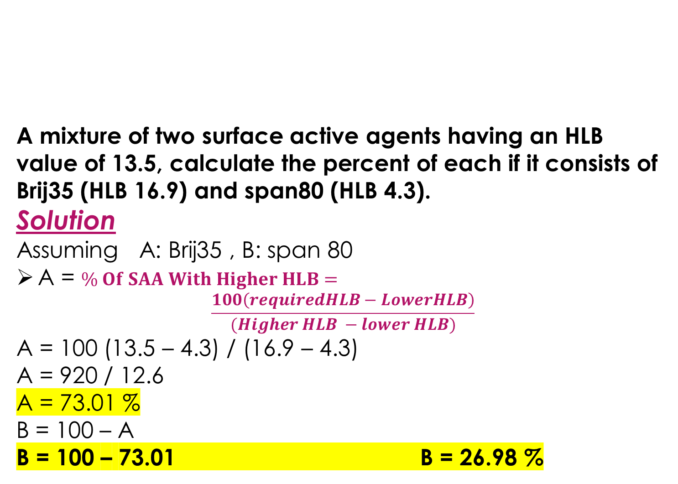
Problem 2
A mixture of two surface active agents having an HLB value of 13.5, calculate the percent of each if it consists of Brij35 (HLB 16.9) and span80 (HLB 4.3).
Solution
Assuming A: Brij35 , B: span 80
A = $\% Of SAA With Higher HLB=$
$$\frac{100\left(requiredHLB−LowerHLB\right)}{(Higher HLB −lower HLB)}$$
A = 100 (13.5 – 4.3) / (16.9 – 4.3)
A = 920 / 12.6
A = 73.01 %
B = 100 – A
B = 100 – 73.01 B = 26.98 %

Slide 16
Calculation of HLB of a mixture of Two Or More SAA :
HLB Mix = ( Fraction of Surfactant A X HLB of Surfactant A ) +( Fraction of Surfactant B X HLB of Surfactant B ) + ( ………………………..)

Slide 17
Problem 3
What is the HLB value of a surfactant blend consisting of 20% tween20 (HLB 16.7), 30% span20 (HLB 8.6) and 50% span80 (HLB 4.3).
Solution
Assuming A: tween 20 , B: span 20 and
C: span80
HLB mixture = fraction of A HLB A+ fraction of B HLB B+ fraction of C HLBC
= (0.2 x 16.7) + (0.3 x 8.6) + (0.5 x 4.3) = 8.07

Slide 20


